Slide 1
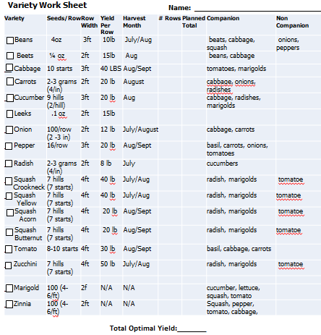
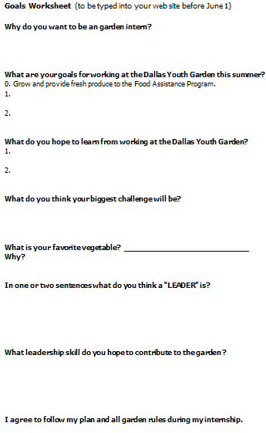
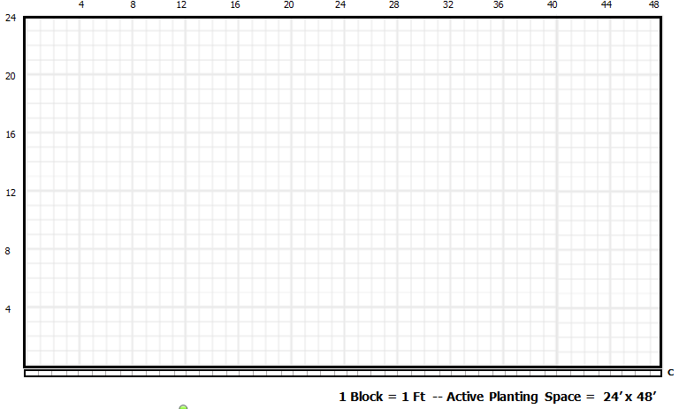
Dallas Youth Garden Plan – Guide
The plan contains four parts
Rules
Rows: 1 Zucchini 1 Flower – 1 Tomato – 1 squash
At least 16 full rows (end of two rows could be used for one experiment each)
1st row is a flower (Zinnia or Marigold)
Not more than 2 rows of flowers
Use at least 3 Companion Plantings AND Avoid Non-Companions
Plant no more than 2 of the same variety per garden
Harvest something in July, August, September
Don’t copy the sample
1. Plan Rules to Follow
2. Variety Work Sheet
4. Questions
3. Map

Slide 2
First Row: Pick a flower (your first row)
Check row width
Color box in
Draw line for row (2 foot wide as each box is one foot)
Zinnia
Label Row
Draw short line where your row will be planted
Rules
Rows: 1 Zucchini 1 Flower – 1 Tomato – 1 squash
At least 16 full rows (end of two rows could be used for one experiment each)
1st row is a flower (Zinnia or Marigold)
Not more than 2 rows of flowers
Use at least 3 Companion Plantings AND Avoid Non-Companions
Plant no more than 2 of the same variety per garden
Harvest something in July, August, September
Don’t copy the sample

Slide 3
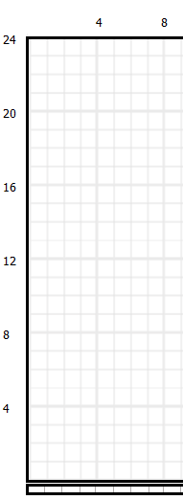
Second Row: Pick a companion plant to zinnia
Color box in
Check row width
Check Month
Check Companion
Draw line for row (4 foot wide as each box is one foot)
Zinnia
Tomato
Label Row
Draw short line where your row will be planted
Color in Border as this is a companion plant (1st of 3)
Rules
Rows: 1 Zucchini 1 Flower – 1 Tomato – 1 squash
At least 16 full rows (end of two rows could be used for one experiment each)
1st row is a flower (Zinnia or Marigold)
Not more than 2 rows of flowers
Use at least 3 Companion Plantings AND Avoid Non-Companions
Plant no more than 2 of the same variety per garden
Harvest something in July, August, September
Don’t copy the sample

Slide 4
Third Row: Pick a companion plant to tomato
Check Month
Check Companion
Color box in
Check row width
Draw line for row (3 foot wide as each box is one foot)
Tomato
Zinnia
Cabbage
Label Row
Draw short line where your row will be planted
Color in Border as this is a companion plant (2nd of 3)
Rules
Rows: 1 Zucchini 1 Flower – 1 Tomato – 1 squash
At least 16 full rows (end of two rows could be used for one experiment each)
1st row is a flower (Zinnia or Marigold)
Not more than 2 rows of flowers
Use at least 3 Companion Plantings AND Avoid Non-Companions
Plant no more than 2 of the same variety per garden
Harvest something in July, August, September
Don’t copy the sample

Slide 5
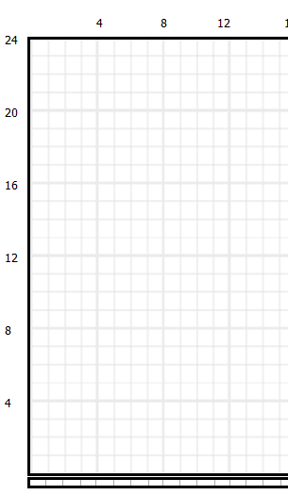
Fourth Row: Pick a companion plan to cabbage
Check Month
Not use companion
Color box in
Check row width
Draw line for row (4 foot wide as each box is one foot)
Zinnia
Cabbage
Tomato
Zucchini
Draw short line where your row will be planted
Label Row
No companion (but avoided noncompanion)
Rules
Rows: 1 Zucchini 1 Flower – 1 Tomato – 1 squash
At least 16 full rows (end of two rows could be used for one experiment each)
1st row is a flower (Zinnia or Marigold)
Not more than 2 rows of flowers
Use at least 3 Companion Plantings AND Avoid Non-Companions
Plant no more than 2 of the same variety per garden
Harvest something in July, August, September
Don’t copy the sample

Slide 6
Additional Rows: Continue until all filled up

Slide 7
Calculate Total Produce
Count Rows
(Yield Per Row ) X (#rows) = Planned Total
= Add up all planned totals column

Slide 8
Answer Questions & Sign
Your Done!

